Slide 1

Confirmation Orientation
August 20, 2025
6:00 P.M.

Slide 2

Confirmation is when a person says “Yes! The faith that God gave me in my baptism is true and I make it my own.”
A period of time where one studies the core teachings of the faith and publicly announces before the church that he/she will stay committed to Jesus Christ one’s whole life.

Slide 3
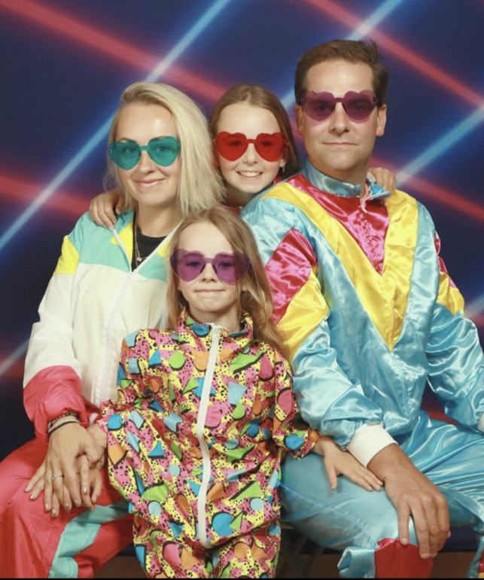
Necessity of Family
The center of life, society, and culture starts in the home. It is the primary location of faith building and nurturing.
Read Deuteronomy 6:1-9

Slide 4
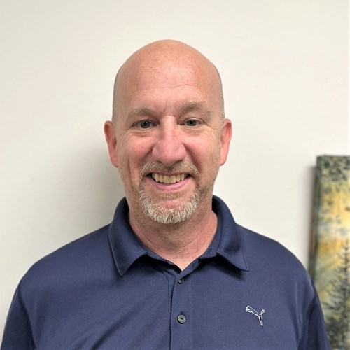
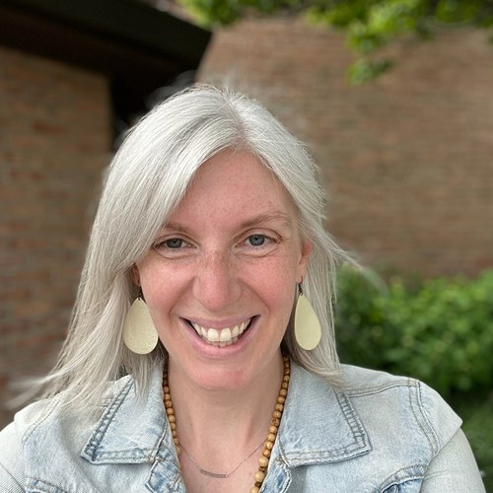
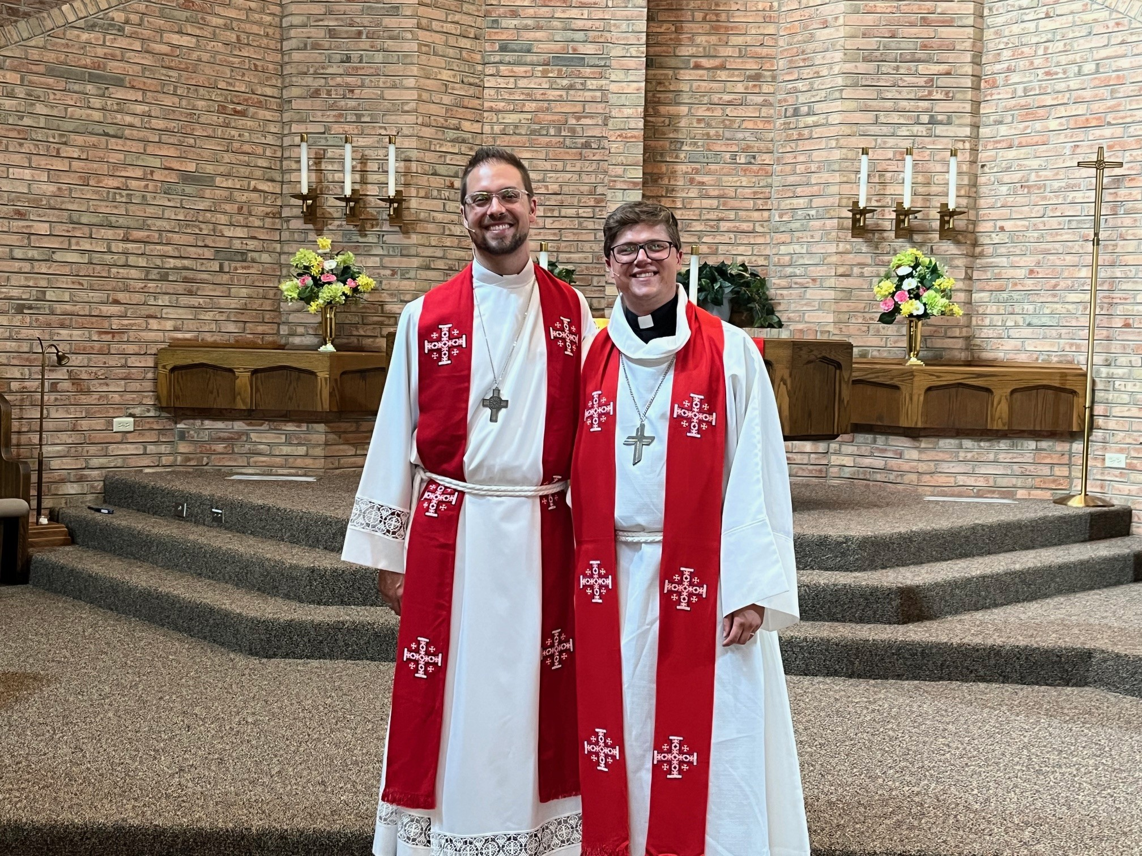
Instructors

Slide 5

Let’s Eat!
We ask that each confirmand pay $50 (covers the cost of food for the year).

Slide 6
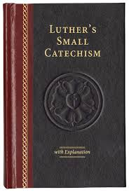
Materials
A Bible (NIV or ESV is preferred)
Writing utensils
Please purchase Luther’s Small Catechism with Explanation.
(2017 edition) www.cph.org

Slide 7
Why do we use Luther’s Small Catechism?
Catechism comes from the Greek word “Katecheo” which means “to teach.”
Martin Luther sought to make the faith known in the home.
6 Chief Parts: 10 Commandments, The Creed, The Lord’s Prayer, Baptism, Confession,
Lord’s Supper

Slide 8
How Confirmation Is Taught
Content –What is it?
Context – Where do we get this from?
Confession – How has the church taught this throughout time?
Considerations – How do we see this from other angles?
Connection – How do I apply this?

Slide 9
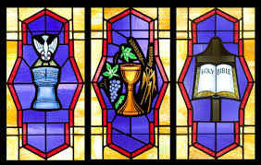
What will be taught this year?
Creation & Scripture
Ten Commandments
The Lord’s Supper
Baptism
Apostles’ Creed
Lord’s Prayer
Living out Faith

Slide 10

Miss A Week of Class?
Go to www.immanuelbatavia.org
Click on Ministry tab.
Click on Confirmation Resources

Slide 11
Standards
Confirmands: When you come to worship, please sign in!
Each confirmand must acolyte at least FOUR TIMES.
Attend Advent and Lent Midweek Worship in addition to weekends.
6 Sermon Notes are due by Confirmation Day.
Completed Confirmation Exam (8th grade only) before Confirmation Day

Slide 12

Expectations
Please arrive on time for class when scheduled.
We ask that 1 parent sit with each confirmand in each class. Explain why.
Come joyful and ready to learn!
Please immerse yourself in the life of worship and congregation!

Slide 13
See Handout on Resilient Disciples.

Slide 14
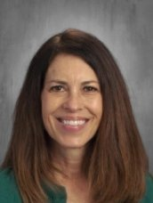
A Word About Prayer Partners!
~ Erica Ciro

Slide 15

Confirmation Day
Saturday, May 9
5:30 P.M.

Slide 16

Parent Checklist
Purchase 2017 edition of Luther’s Small Catechism (with explanation)
$50 due by October 1st (covers food for year).
Ensure confirmand signs into weekly worship in Narthex.
Attend confirmation with child each week.

Slide 17

Questions? nkegley@ilcsbatavia.org
262-302-9575

Slide 18
Have A Great Night!

